Slide 1
Chapter 4: Implementing Firewall Technologies
CCNA Security v2.0

Slide 2
Chapter Outline
4.0 Introduction
4.1 Access Control Lists
4.2 Firewall Technologies
4.3 Zone-Based Policy Firewalls
4.4 Summary

Slide 3
Section 4.1: Access Control List
Upon completion of this section, you should be able to:
Configure standard and extended IPv4 ACLs using CLI.
Use ACLs to mitigate common network attacks.
Configure IPv6 ACLs using CLI.

Slide 4
Topic 4.1.1: Configuring Standard and Extended IPv4 ACLs with CLI

Slide 5
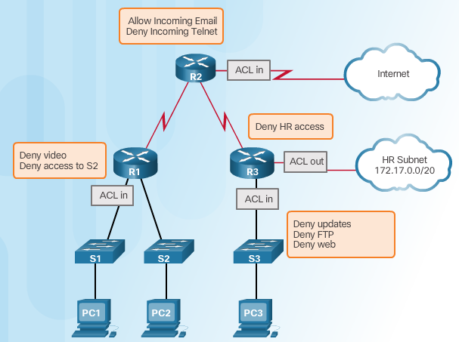
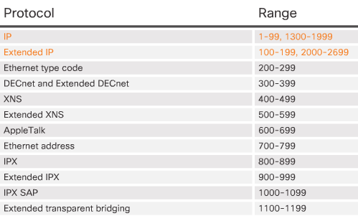
Introduction to Access Control Lists
Historically, the type of ACL could be identified by the number, as shown in Figure 2. For example, numbered ACLs with a range of 200–299 were used to control traffic according to Ethernet type. An ACL numbered 700–799 would indicate that the traffic is classified and controlled based on MAC addresses.
Today, when classifying traffic, the most common types of ACLs use IPv4 and IPv6 addresses and Transmission Control Protocol (TCP) and User Datagram Protocol (UDP) port numbers. Standard and extended IPv4 ACLs can be named or numbered. IPv6 ACLs must use a name.
Notes:
4.1.1.1 Introduction to Access Control Lists

Slide 6
Configuring Numbered and Named ACLs
Standard Numbered ACL Syntax
Extended Numbered ACL Syntax
Named ACL Syntax
Standard ACE Syntax
Extended ACE Syntax
Notes:
4.1.1.2 Configuring Numbered and Named ACLs

Slide 7
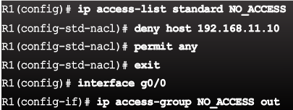
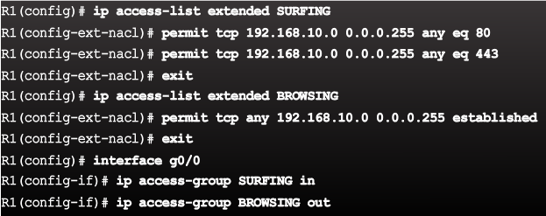
Applying an ACL
Syntax - Apply an ACL to an interface
Syntax - Apply an ACL to the VTY lines
Example - Named Standard ACL
Example - Named Extended ACL
Notes:
4.1.1.3 Applying an ACL

Slide 8
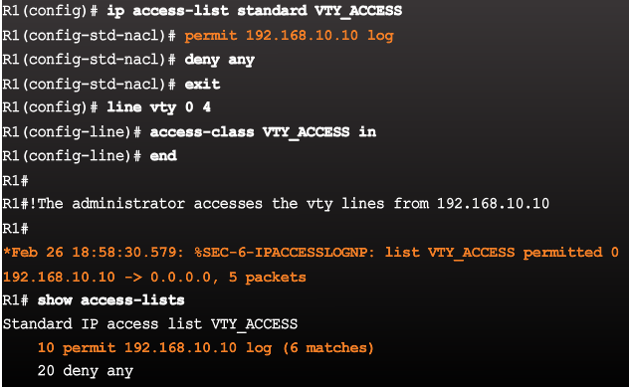
Applying an ACL (Cont.)
Figure 4 shows a named standard ACL applied to inbound traffic on the vty lines. Logging has been enabled with the log parameter. Log messages are generated on the first packet match and then at five minute intervals after that first packet match. You can use the show access-list command to see how many packets have matched a statement.
Syntax - Apply an ACL to the VTY lines
Example - Named ACL on VTY lines with logging
Notes:
4.1.1.3 Applying an ACL

Slide 9
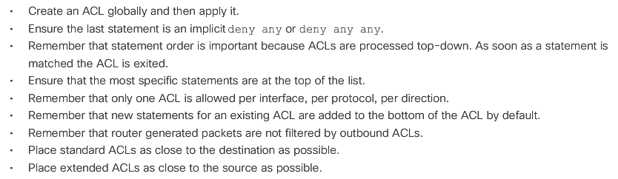
ACL Configuration Guidelines
Notes:
4.1.1.4 ACL Configuration Guidelines

Slide 10
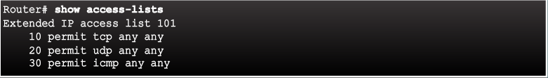

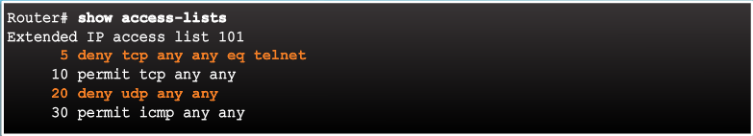
Editing Existing ACLs
Existing access list has three entries
Access list has been edited, which adds a new ACE and replaces ACE line 20.
Updated access list has four entries
Notes:
4.1.1.5 Editing Existing ACLs

Slide 11
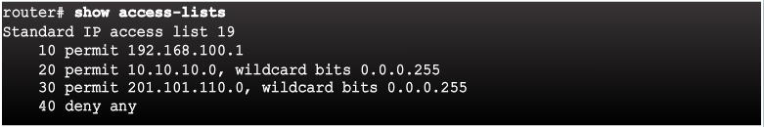
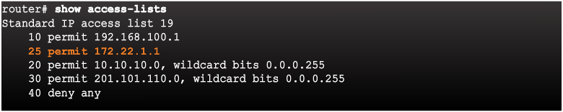
Sequence Numbers and Standard ACLs
On standard access lists, the Cisco IOS applies an internal logic to configuring ACEs and verifying ACLs. The host statements (those with specific IPv4 addresses) are listed first, but not necessarily in the order that they were entered. First, the IOS puts host statements in a particular order determined by a special hashing function. The resulting order optimizes the search for a host ACL entry. It is not necessarily in order of IPv4 addresses.
Existing access list has four entries
Access list has been edited, which adds a new ACE that permits a specific IP address.
Updated access list places the new ACE before line 20
Notes:
4.1.1.6 Sequence Numbers and Standard ACLs
4.1.1.7 Activity - Configure Standard ACLs
4.1.1.8 Activity - Create an Extended ACL Statement
4.1.1.9 Activity - Evaluate Extended ACL Statements
4.1.1.10 Packet Tracer - Configure Extended ACLs Scenario 1
4.1.1.11 Packet Tracer - Configure Extended ACLs Scenario 2

Slide 12
Topic 4.1.2: Mitigating Attacks with ACLs

Slide 13
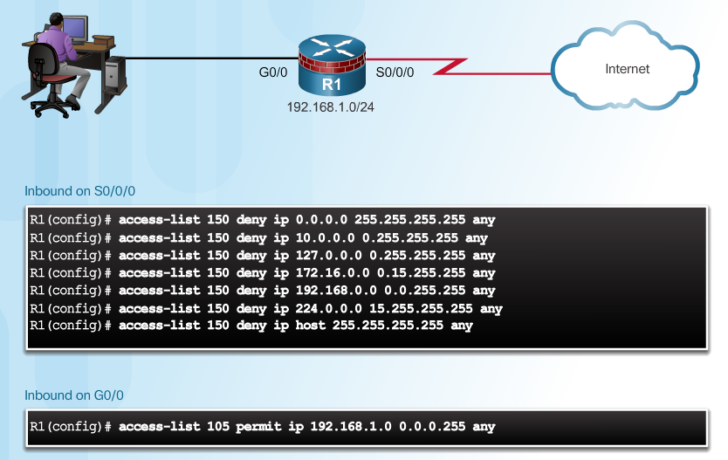
Antispoofing with ACLs
Notes:
4.1.2.1 Antispoofing with ACLs

Slide 14
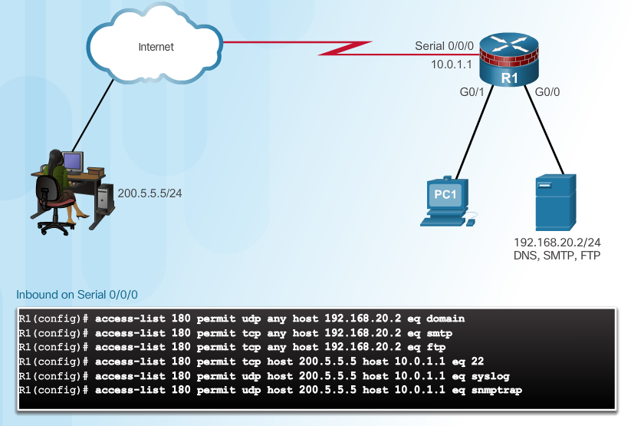
Permitting Necessary Traffic through a Firewall
An effective strategy for mitigating attacks is to explicitly permit only certain types of traffic through a firewall.
Notes:
4.1.2.2 Permitting Necessary Traffic through a Firewall

Slide 15
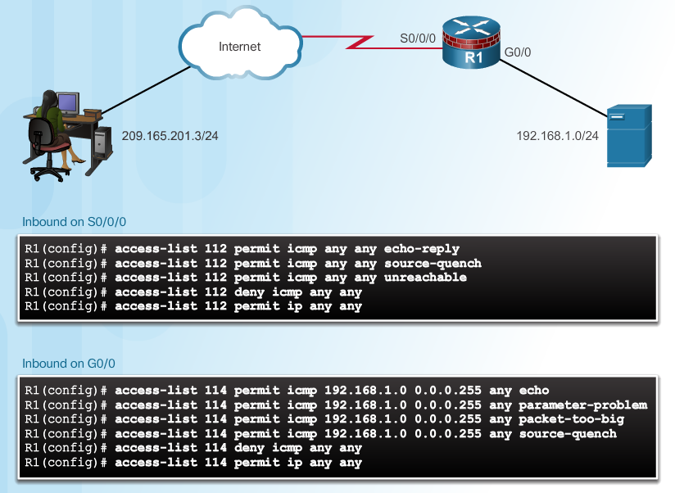
Mitigating ICMP Abuse
Several ICMP messages are recommended for proper network operation and should be allowed into the internal network:
Echo reply - Allows users to ping external hosts.
Source quench - Requests that the sender decrease the traffic rate of messages.
Unreachable - Generated for packets that are administratively denied by an ACL.
Echo - Allows users to ping external hosts.
Parameter problem - Informs the host of packet header problems.
Packet too big – Enables packet maximum transmission unit (MTU) discovery.
Source quench - Throttles down traffic when necessary.
Several ICMP messages are required for proper network operation and should be allowed to exit the network:
Notes:
4.1.2.3 Mitigating ICMP Abuse
The ICMP Parameter problem message is generated as a response for any error not specifically covered by another ICMP message.

Slide 16
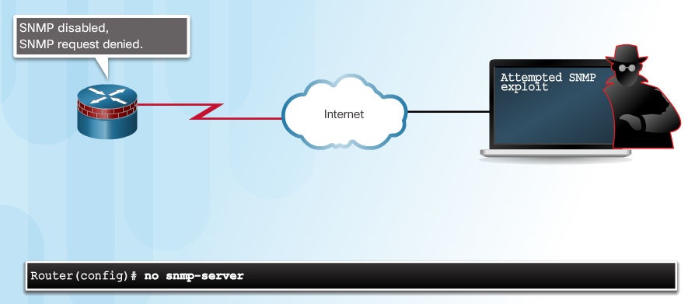
Mitigating SNMP Exploits
The most effective means of exploitation prevention is to disable the SNMP server on IOS devices for which it is not required. As shown in the figure, use the command no snmp-server to disable SNMP processing on the Cisco IOS devices.
Notes:
4.1.2.4 Mitigating SNMP Exploits
4.1.2.5 Packet Tracer - Configure IP ACLs to Mitigate Attacks

Slide 17
Topic 4.1.3: IPv6 ACLs

Slide 18
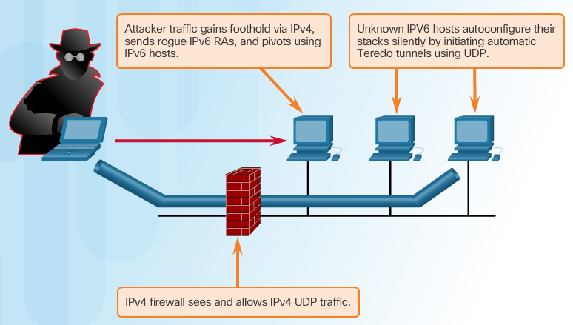
Introducing IPv6 ACLs
Attackers can accomplish stealth attacks that result in trust exploitation by using dual stacked hosts, rogue Neighbor Discovery Protocol (NDP) messages, and tunneling techniques.
Teredo tunneling, for example, is an IPv6 transition technology that provides automatic IPv6 address assignment when IPv4/IPv6 hosts are located behind IPv4 network address translation (NAT) devices.
It accomplishes this by embedding the IPv6 packets inside IPv4 UDP packets. The attacker gains a foothold in the IPv4 network. The compromised host sends rogue router advertisements, which triggers dual stacked hosts to obtain an IPv6 address.
Notes:
4.1.3.1 Introducing IPv6 ACLs

Slide 19
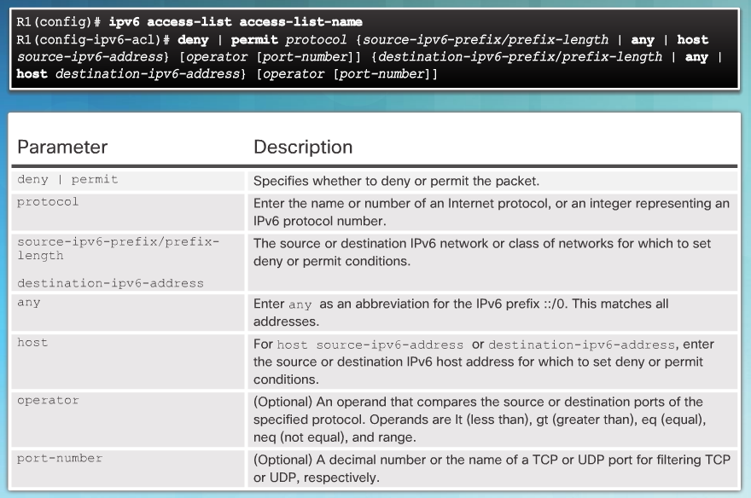
IPv6 ACL Syntax
Notes:
4.1.3.2 IPv6 ACL Syntax

Slide 20
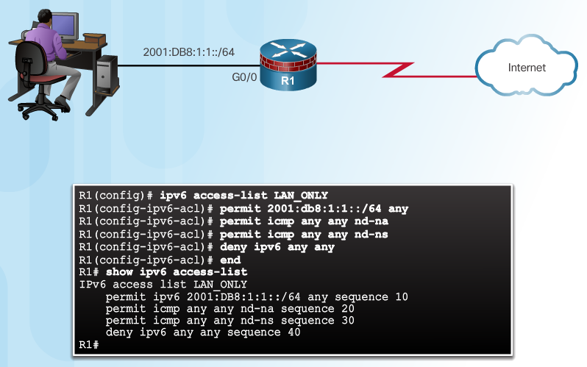
Configure IPv6 ACLs
An IPv6 ACL contains an implicit deny ipv6 any. Each IPv6 ACL also contains implicit permit rules to enable IPv6 neighbor discovery.
The IPv6 NDP requires the use of the IPv6 network layer to send neighbor advertisements (NAs) and neighbor solicitations (NSs).
If an administrator configures the deny ipv6 any command without explicitly permitting neighbor discovery, then the NDP will be disabled.
Notes:
4.1.3.3 Configure IPv6 ACLs
4.1.3.4 Packet Tracer - Configure IPv6 ACLs

Slide 21
Section 4.2: Firewall Technologies
Upon completion of this section, you should be able to:
Explain how firewalls are used to help secure networks.
Describe the various types of firewalls.
Configure a classic firewall.
Explain design considerations for implementing firewall technologies.

Slide 22
Topic 4.2.1: Securing Networks with Firewalls

Slide 23
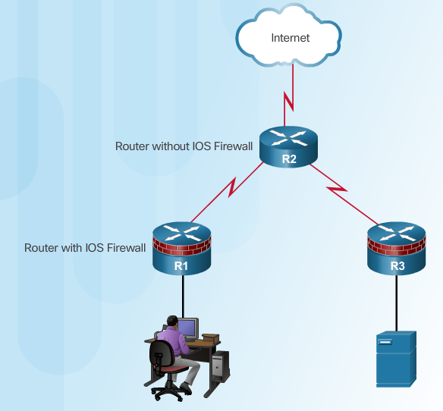
Defining Firewalls
The term was adapted for use with computer networks: a firewall prevents undesirable traffic from entering prescribed areas within a network.
All firewalls:
Are resistant to attack
Are the only transit point between networks because all traffic flows through the firewall
Enforce the access control policy
Notes:
4.2.1.1 Defining Firewalls

Slide 24
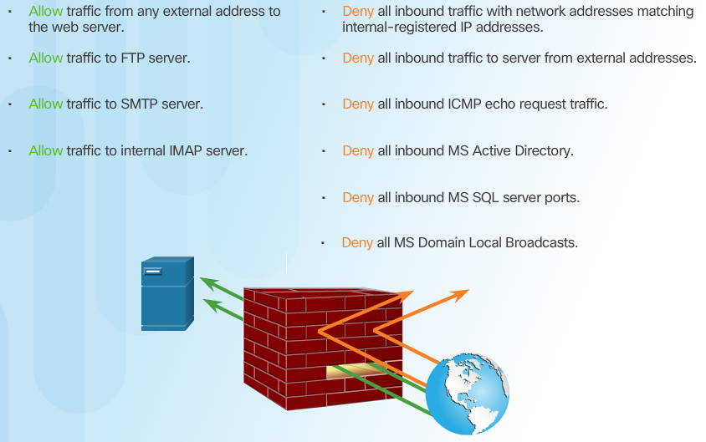
Benefits and Limitations of Firewalls
Notes:
4.2.1.2 Benefits and Limitations of Firewalls

Slide 25
Topic 4.2.2: Types of Firewalls

Slide 26
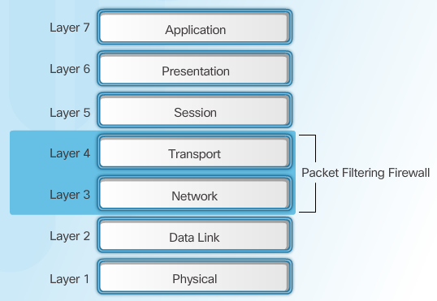
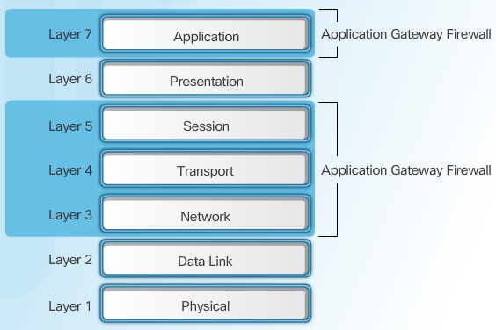
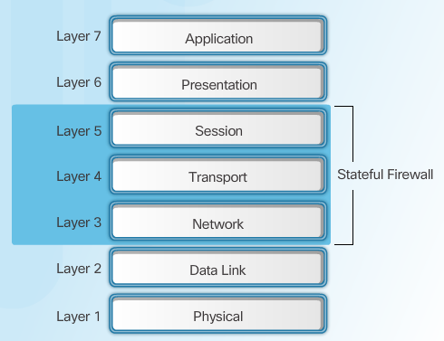
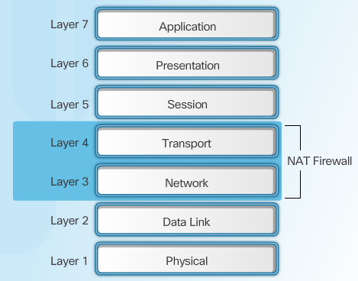
Firewall Type Descriptions
Packet Filtering Firewall
Application Gateway Firewall
Packet filtering firewall - Typically a router with the capability to filter some packet content, such as Layer 3 and sometimes Layer 4 information (Figure 1).
Application gateway firewall (proxy firewall) - Filters information at Layers 3, 4, 5, and 7 of the OSI reference model. Most of the firewall control and filtering is done in software (Figure 3). When a client needs to access a remote server, it connects to a proxy server. The proxy server connects to the remote server on behalf of the client. Therefore, the server only sees a connection from the proxy server.
Stateful Firewall
NAT Firewall
Stateful firewall - Monitors the state of connections, whether the connection is in an initiation, data transfer, or termination state (Figure 2).
Notes:
4.2.2.1 Firewall Type Descriptions

Slide 27
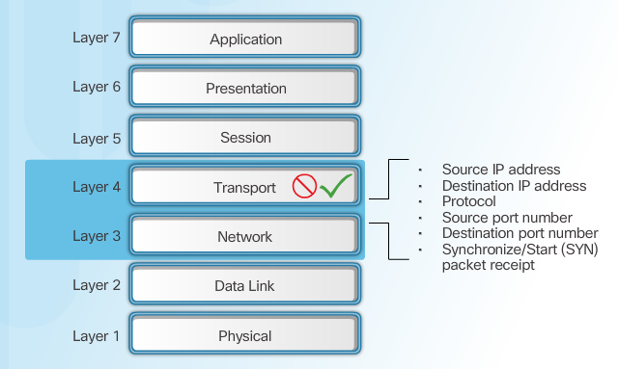
Packet Filtering Firewall Benefits & Limitations
There are several advantages of using a packet filtering firewall:
Packet filters implement simple permit or deny rule sets.
Packet filters have a low impact on network performance.
Packet filters are easy to implement, and are supported by most routers.
Packet filters provide an initial degree of security at the network layer.
Packet filters perform almost all the tasks of a high-end firewall at a much lower cost.
Notes:
4.2.2.2 Packet Filtering Firewall Benefits and Limitations

Slide 28
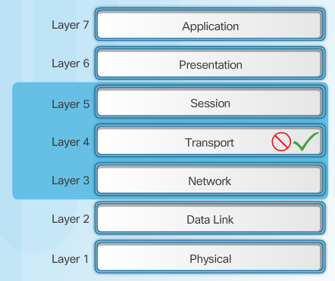
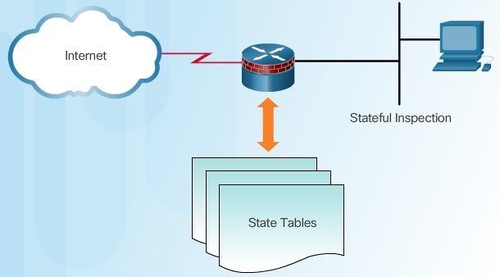
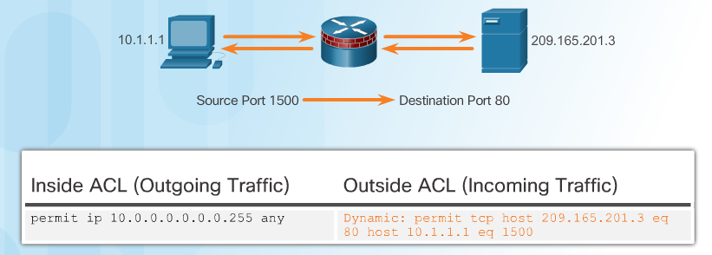
Stateful Firewalls
Stateful Firewalls
State Tables
Stateful Firewall Operation
Notes:
4.2.2.3 Stateful Firewalls

Slide 29
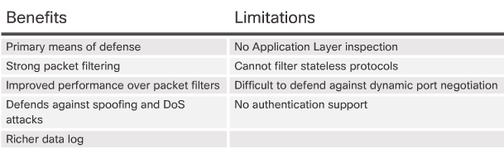
Stateful Firewall Benefits and Limitations
Next Generation Firewalls
Granular identification, visibility, and control of behaviors within applications
Restricting web and web application use based on the reputation of the site
Proactive protection against Internet threats
Enforcement of policies based on the user, device, role, application type, and threat profile
Performance of NAT, VPN, and SPI
Use of an IPS
Notes:
4.2.2.4 Stateful Firewall Benefits and Limitations
4.2.2.5 Next Generation Firewalls
4.2.2.6 Video Tutorial - Cisco ASA with FirePOWER Services
4.2.2.7 Activity - Identify the Type of Firewall

Slide 30
Topic 4.2.3: Classic Firewall

Slide 31
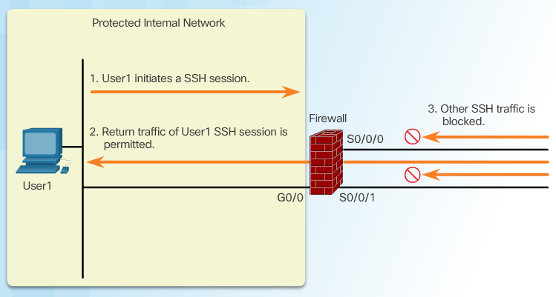
Introducing Classic Firewall
Cisco IOS Classic Firewall, formerly known as context-based access control (CBAC), is a stateful firewall feature added to the Cisco IOS prior to version 12.0.
Classic Firewall provides four main functions: traffic filtering (shown in the figure), traffic inspection, intrusion detection, and generation of audits and alerts.
Notes:
4.2.3.1 Introducing Classic Firewall

Slide 32
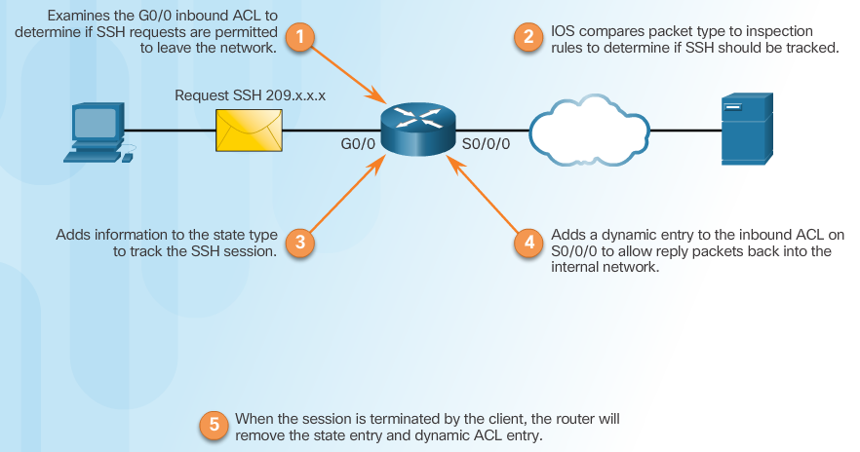
Classic Firewall Operation
Notes:
4.2.3.2 Classic Firewall Operation

Slide 33
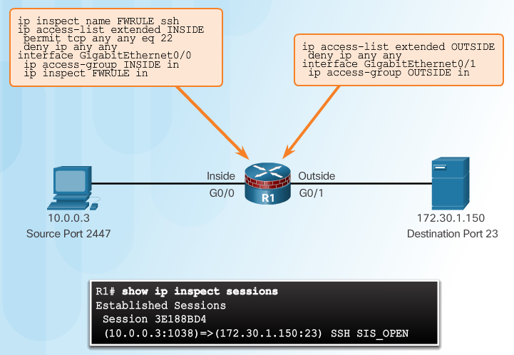
Classic Firewall Configuration
Choose the internal and external interfaces.
Configure ACLs for each interface.
Define inspection rules.
Apply an inspection rule to an interface.
Inspection Rules
Notes:
4.2.3.3 Classic Firewall Configuration

Slide 34
Topic 4.2.4: Firewalls in Network Design

Slide 35
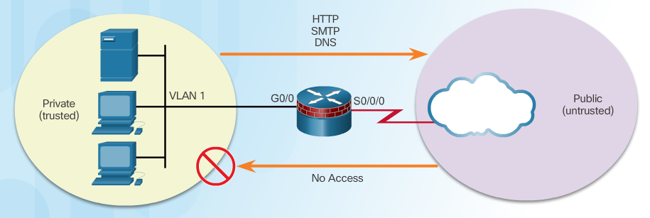
Inside and Outside Networks
Notes:
4.2.4.1 Inside and Outside Networks

Slide 36
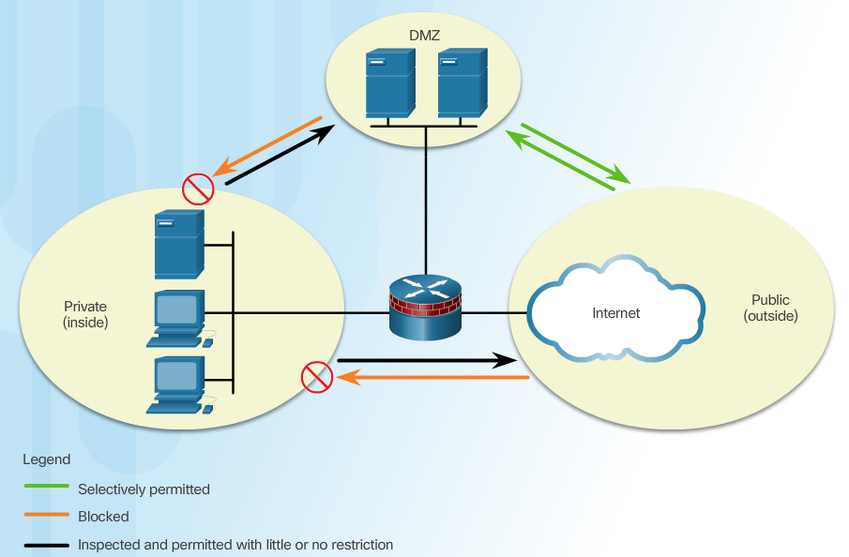
Demilitarized Zones
Notes:
4.2.4.2 Demilitarized Zones

Slide 37
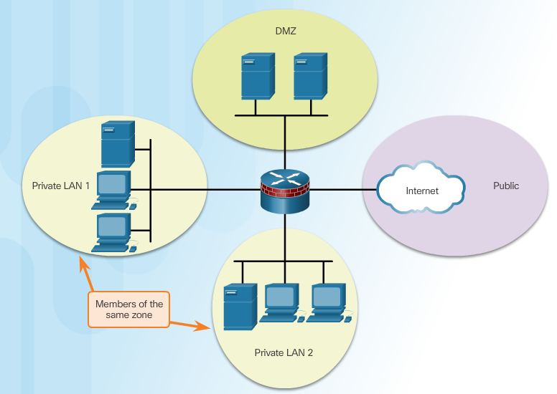
Zone-Based Policy Firewalls
Notes:
4.2.4.3 Zone-Based Policy Firewalls

Slide 38
Layered Defense
Considerations for network defense:
Network core security
Perimeter security
Endpoint security
Communications security
Firewall best practices include:
Position firewalls at security boundaries.
It is unwise to rely exclusively on a firewall for security.
Deny all traffic by default. Permit only services that are needed.
Ensure that physical access to the firewall is controlled.
Monitor firewall logs.
Practice change management for firewall configuration changes.
Remember that firewalls primarily protect from technical attacks originating from the outside.
Notes:
4.2.4.4 Layered Defense

Slide 39
Section 4.3: Zone-Based Policy Firewalls
Upon completion of this section, you should be able to:
Explain how Zone-Based Policy Firewalls are used to help secure a network.
Explain the operation of a Zone-Based Policy Firewall.
Configure a Zone-Based Policy Firewall with CLI.

Slide 40
Topic 4.3.1: Zone-Based Policy Firewall Overview

Slide 41
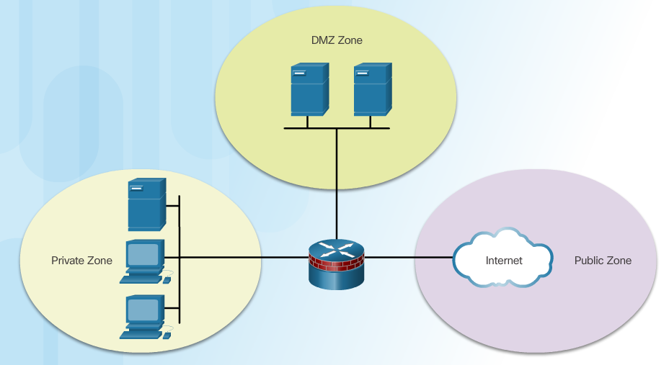
Benefits of ZPF
Not dependent on ACLs
Router security posture is to block unless explicitly allowed
Policies are easy to read and troubleshoot with C3PL
One policy affects any given traffic, instead of needing multiple ACLs and inspection actions
Notes:
4.3.1.1 Benefits of ZPF

Slide 42
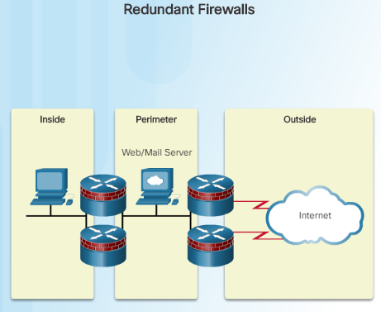
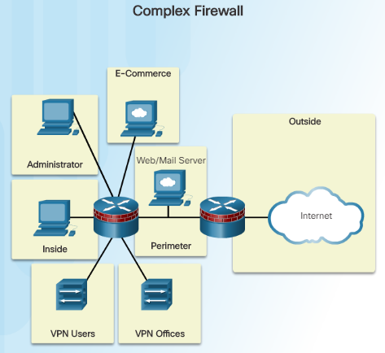
ZPF Design
Common designs include:
LAN-to-Internet
Firewalls between public servers
Redundant firewalls
Complex firewalls
Design steps:
Determine the zones
Establish policies between zones
Design the physical infrastructure
Identify subsets within zones and merge traffic requirements
Notes:
4.3.1.2 ZPF Design
4.3.1.3 Activity - Compare Classic Firewall and ZPF Operation

Slide 43
Topic 4.3.2: ZPF Operation

Slide 44
ZPF Actions
Inspect - Configures Cisco IOS stateful packet inspections.
Drop - Analogous to a deny statement in an ACL. A log option is available to log the rejected packets.
Pass - Analogous to a permit statement in an ACL. The pass action does not track the state of connections or sessions within the traffic.
Notes:
4.3.2.1 ZPF Actions

Slide 45
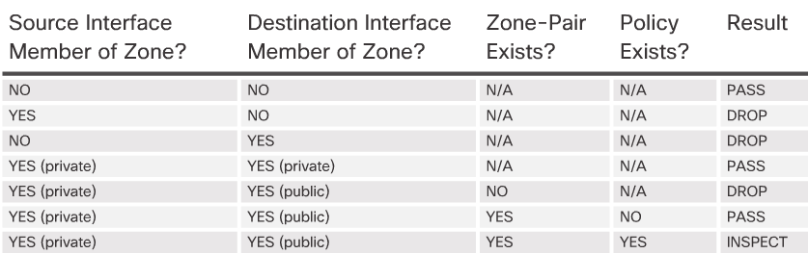
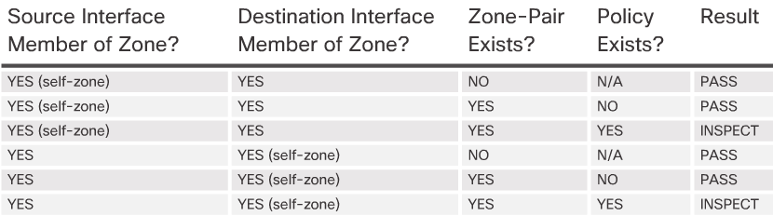
Rules for Transit Traffic
Rules for Traffic to the Self Zone
Notes:
4.3.2.2 Rules for Transit Traffic
4.3.2.3 Rules for Traffic to the Self Zone
4.3.2.4 Activity - Rules for Transit Traffic

Slide 46
Topic 4.3.3: Configuring a ZPF

Slide 47
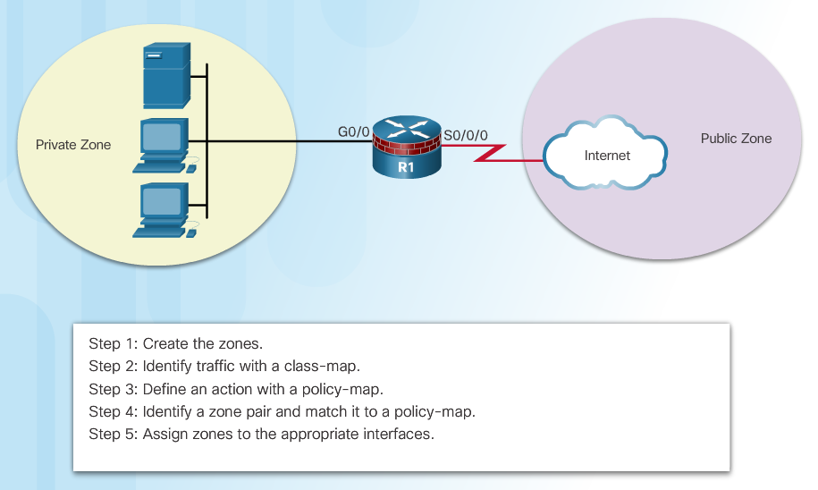
Configure ZPF
Notes:
4.3.3.1 Configure ZPF

Slide 48
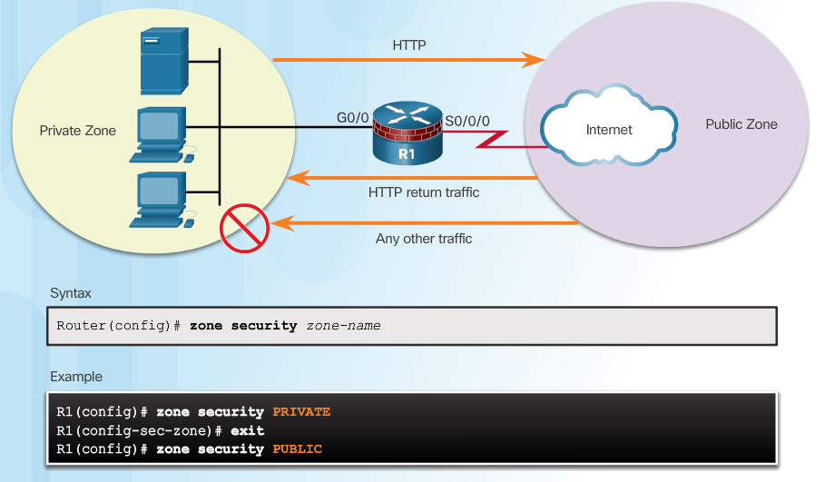
Step 1: Create Zones
Notes:
4.3.3.2 Create Zones

Slide 49
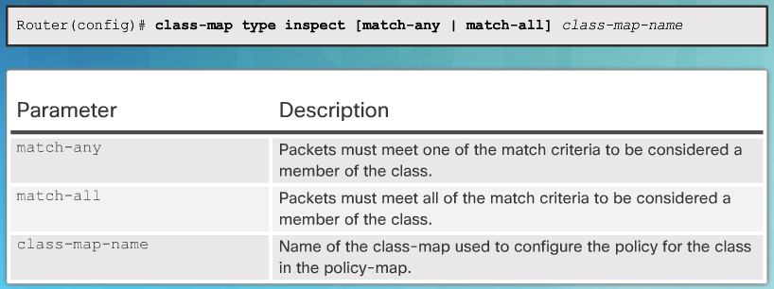
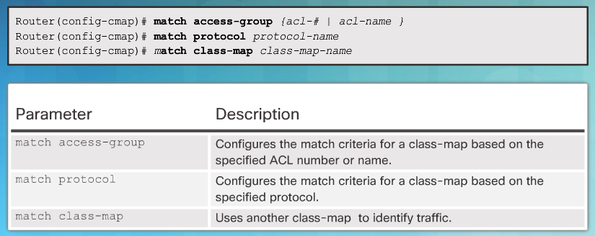
Step 2: Identify Traffic
Command Syntax for class-map
Sub-Configuration Command Syntax for class-map
Notes:
4.3.3.3 Identify Traffic

Slide 50
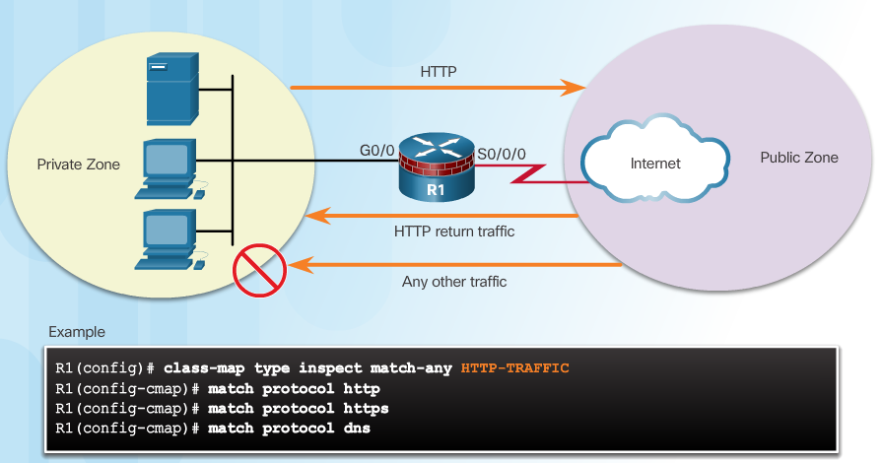
Step 2: Identify Traffic (Cont.)
Example class-map Configuration
Notes:
4.3.3.3 Identify Traffic

Slide 51
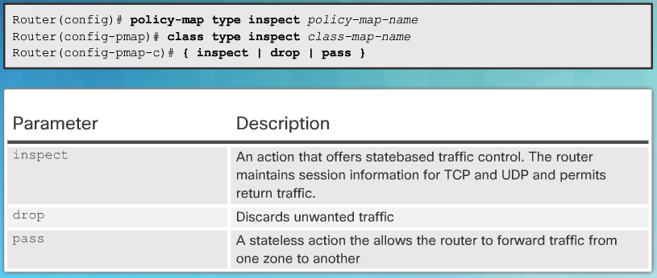
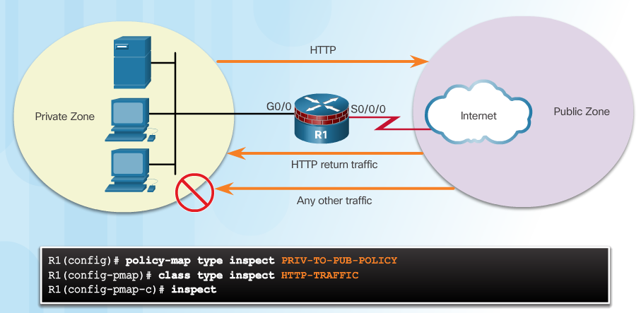
Step 3: Define an Action
Command Syntax for policy-map
Example policy-map Configuration
Notes:
4.3.3.4 Define an Action

Slide 52
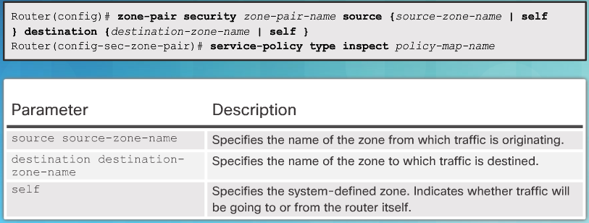
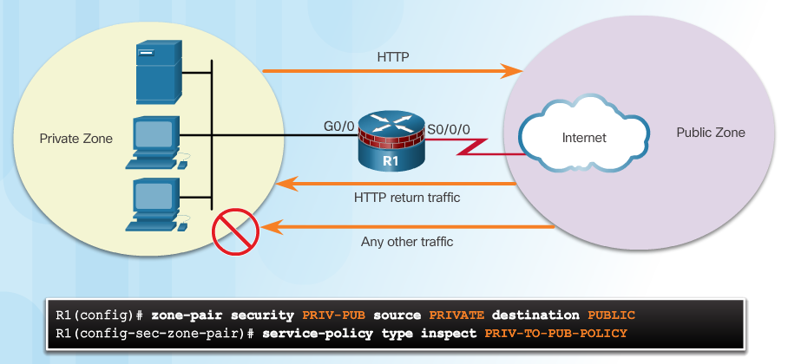
Step 4: Identify a Zone-Pair and Match to a Policy
Command Syntax for zone-pair and service-policy
Example service-policy Configuration
Notes:
4.3.3.5 Identify a Zone-Pair and Match to a Policy

Slide 53
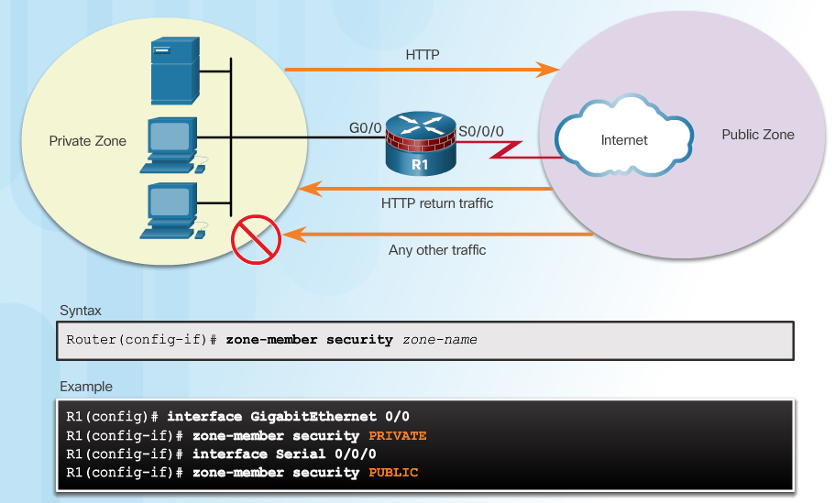
Step 5: Assign Zones to Interfaces
Notes:
4.3.3.6 Assign Zones to Interfaces

Slide 54
Verify a ZPF Configuration
Verification commands:
show run | begin class-map
show policy-map type inspect zone-pair sessions
show class-map type inspect
show zone security
show zone-pair security
show policy-map type inspect
ZPF Configuration Considerations
No filtering is applied for intra-zone traffic
Only one zone is allowed per interface.
No Classic Firewall and ZPF configuration on same interface.
If only one zone member is assigned, all traffic is dropped.
Only explicitly allowed traffic is forwarded between zones.
Traffic to the self zone is not filtered.
Notes:
4.3.3.7 Verify a ZPF Configuration
Syntax Checker - Configure Zone-Based Policy Firewall with CLI
4.3.3.8 ZPF Configuration Considerations
4.3.3.9 Video Demonstration - ZPFs

Slide 55
Section 4.4: Summary
Chapter Objectives:
Implement ACLs to filter traffic and mitigate network attacks on a network.
Configure a classic firewall to mitigate network attacks.
Implement ZPF using CLI.
Notes:
4.4.1.1 Packet Tracer - Configuring a ZPF
4.4.1.2 Lab - Configuring ZPFs
4.4.1.3 Summary

Slide 57
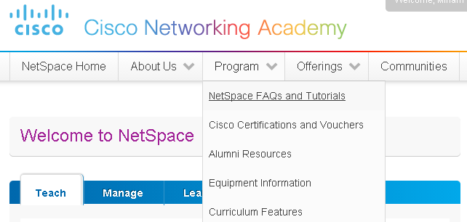

Instructor Resources
Remember, there are helpful tutorials and user guides available via your NetSpace home page. (https://www.netacad.com)
These resources cover a variety of topics including navigation, assessments, and assignments.
A screenshot has been provided here highlighting the tutorials related to activating exams, managing assessments, and creating quizzes.
1
2
Notes:
https://www.netacad.com

